Slide 1
.Net
WEB ENGINEERING

Slide 2
Week 2 - Day 8

Slide 3

UI

Slide 4
Recap Questions
The following questions will be asked to the participants for review:
What is
jQuery Syntax
jQuery Selectors
Manipulating HTML DOM with jQuery
CSS Manipulation
Animation (fade, slide, hide, show)

Slide 5

Learning Objectives
By the end of this session, the students will have developed an understanding of:
Creating a rich user interface using jQuery UI

Slide 6
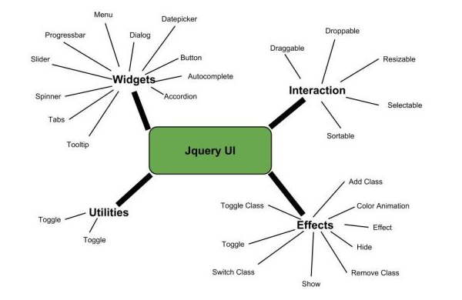
What is jQuery UI?
Notes:
jQuery is an efficient & fast JavaScript Library created by John Resig in 2006. The motto of jQuery is write less, do more, which is very apt because it’s functionality revolves around simplifying each and every line of code. Here is a list of jQuery key features:

Slide 7
Features
jQueryUI is categorized into four groups, interactions, widgets, effects, utilities. These will be discussed in detail in the subsequent chapters. The structure of the library is as shown in the image below:
Interactions − These are the interactive plugins like drag, drop, resize and more which give the user the ability to interact with DOM elements.
Widgets − Using widgets which are jQuery plugins, you can create user interface elements like accordion,datepicker etc.

Slide 8
Features
Effects − These are built on the internal jQuery effects. They contain a full suite of custom animations and transitions for DOM elements.
Utilities − These are a set of modular tools the JqueryUI library uses internally.

Slide 9
jQuery UI Interactions

Slide 10
1) Interactions
Interactions is a set of mouse-based instructions used as building blocks for rich interfaces and complex widgets. These are the mostly used interactions:
Draggable
Droppable
Resizable
Selectable
Sortable

Slide 11
jQuery UI Widgets

Slide 12
Widgets
Widgets are feature-rich, stateful plugins that have a full life-cycle, along with methods and events. These are the most used widgets:
Accordion
Autocomplete
Dialog
Button
Date Picker
Menu
Progress Bar
Tabs
Tooltip
Slider
Spinner

Slide 13
jQuery UI Effects

Slide 14
Effects
The internal jQuery effects contain a full suite of custom animation and transition for DOM elements. jQuery UI adds support for animating colors and class transitions, as well as providing several additional easings.
Hide
Show
Add Class
Remove Class
Switch Class
Toggle Class
Color Animation
Effect
Toggle

Slide 15
jQuery UI Utilities

Slide 16
Position
It is used to set the position of the element.

Slide 17

Homework
Students will practice exercises of the topics covered today from this link:
JQuery DOM Practice Exercises
&
https://api.jquery.com/animate/

Slide 18

Learning Objectives
By the end of this session, the students have practised
Hide/Show, Fade, and Slide
jQuery Animation
Manipulating CSS with jQuery
Creating a rich user interface using jQuery UI

Slide 19
Conclusion & Q/A
See you tomorrow!

